Slide 1
Predicting Yelp Price Range
Machine Learning - Final Project
Josh Dey
Emmett Powers
Giorlando Ramírez

Slide 2

Method
Yelp Data Competition
Question: Can we determine the price range of a restaurant based on different variables that Yelp has collected?
Models:
Linear Regression
Classification Tree
Ordinal Regression

Slide 3
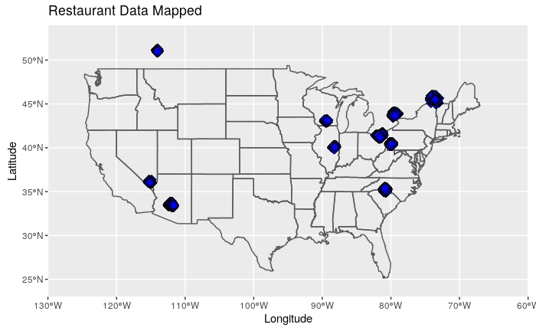

Slide 4
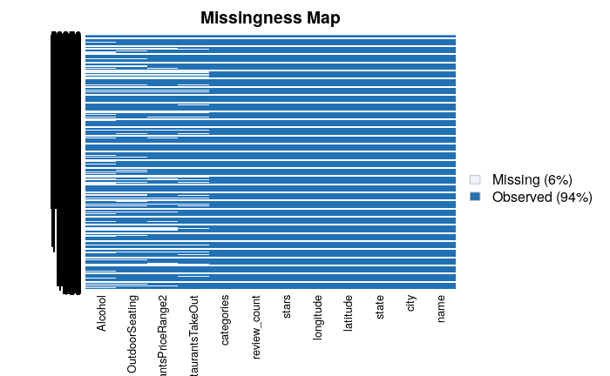

Exploratory Data Analysis
Dependent Variable

Slide 5
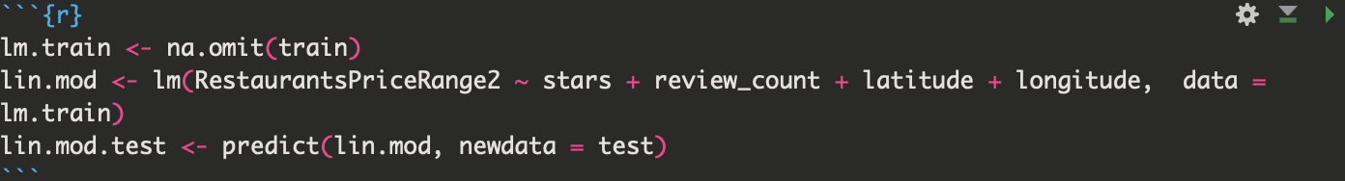
Linear Regression

Slide 6
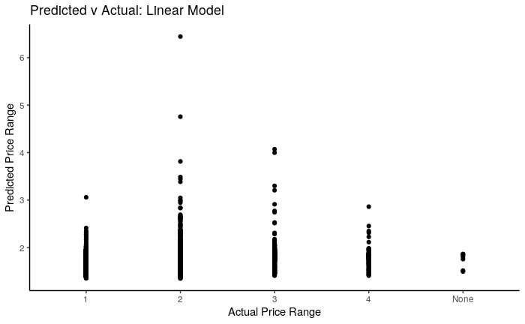
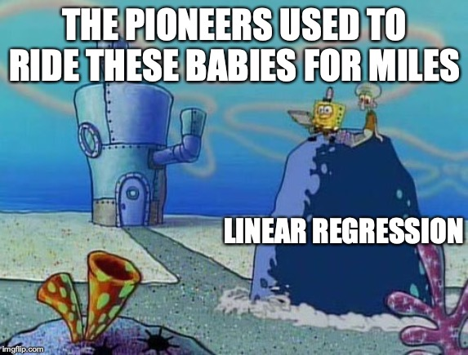
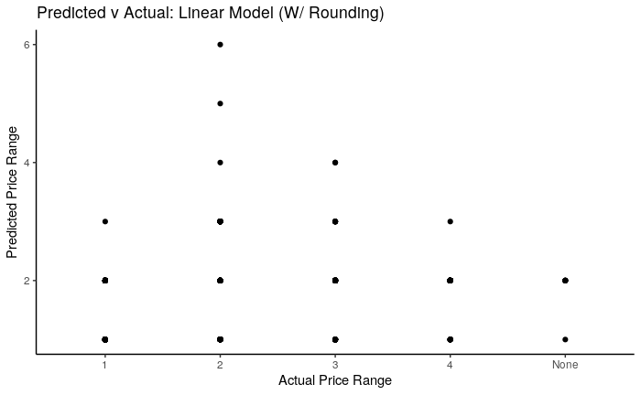
Linear Regression
MCR: .999
Scoring Model
MCR: 0.4185821

Slide 7
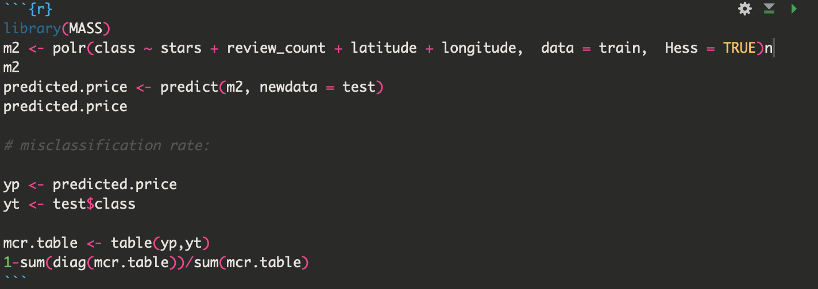
Ordinal Regression

Slide 8
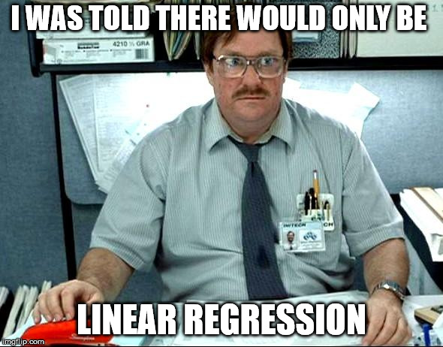
Ordinal Regression
MCR: 0.408191

Slide 9
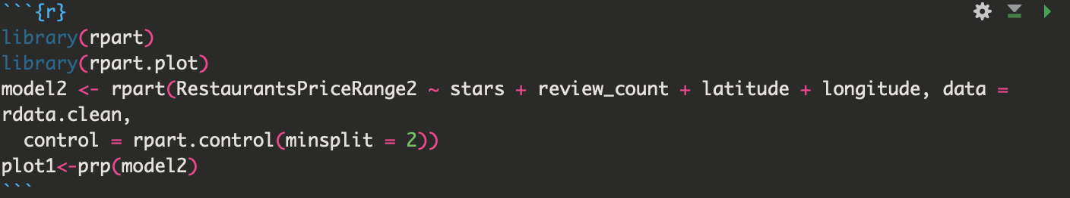
Classification Tree

Slide 10
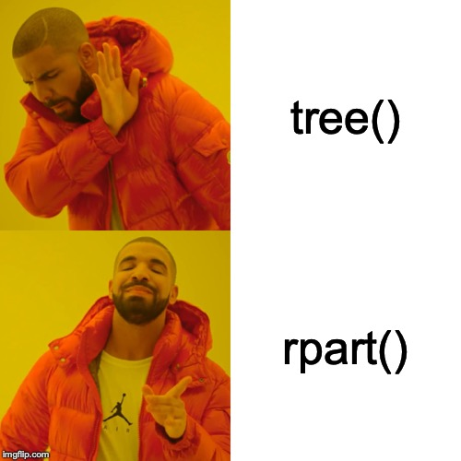

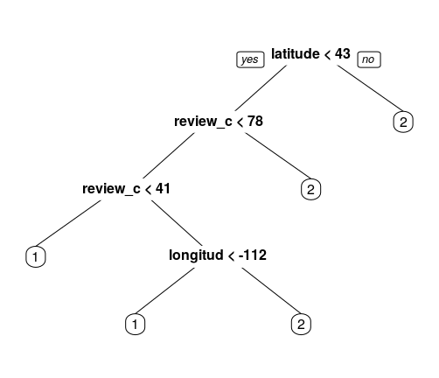
Classification Tree

Slide 11

Improvements
In conclusion, the answer to our original question is kind of…
Improvements to OLR?
Improvements to Linear Regression?

Slide 12

Thank You! Questions?

